Slide 1


Understanding Human Sentiments using AI Based Text Analysis Techniques

Slide 2
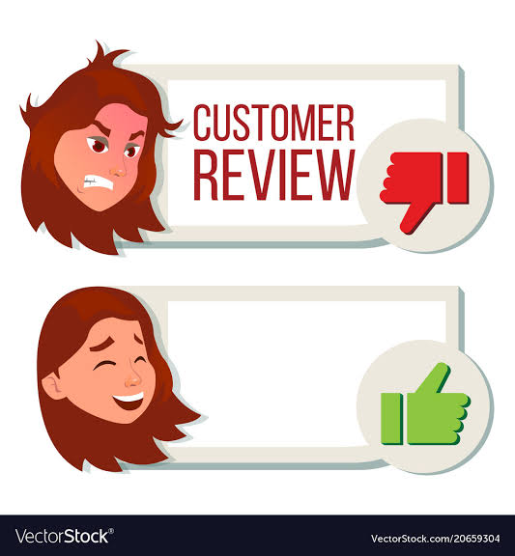
Problem Statement
The Client is in the business of Online Sale of Jewelry items through its website and also TV Channels in USA, UK and Australia. They receive multiple feedback and reviews of their products from all the channels, ( Website, TV Channels etc).
They want us to develop a dashboard, through which they can Analyze the reviews of their products and do a sentiment Analysis of it.

Slide 3
Our Project is divided into three sub-modules!
1.Bulding ML Model.
2.Data Scrapping and Database handling
3.Creation of Dashboard UI.

Slide 4
Dataset used to train the model
1.Amazon Review Dataset under Clothing_Shoes_and_Jewelry Section(2018)(14GB JSON Data).
2.We will read overall rating, reviewtext, summary column from Amazon dataset.
3.We will read 14.4 GB data in chunks
#Sample out the reviews 4.overall=5(4000),overall=4(4000),overall=2(4000),overall=1(4000),overall=3(8000)
5.Total=24K reviews in each chunk and total chunk created=33.
#If overall=5,4(Positive),2,1(Negative),3(Neutral)
#Total 33 csv files will be created in our dataframe.
#We will concat 33 csv files into single csv (balanced_reviews.csv)using pandas.

Slide 5
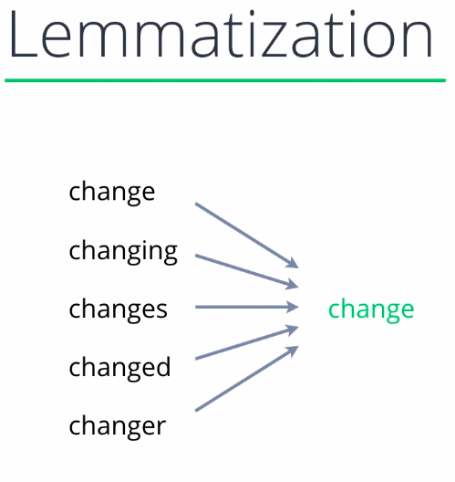
Steps:Building ML Model
Cleaning and preprocessing large dataset
Libraries used:Pandas,Scikit Learn,Numpy,Python
1.EDA(Exploratory Data Analysis)
2.NLP Techniques used:
Regex to clean the reviews(removing unwanted symbols,emojis,etc)
Remove stopwords-Words that do not add much meaning to sentence.Eg-the, he, an, a,etc.
Lemmatization-Several diff form of same word mapped to single word called root /lemma.

Slide 6
Count Vectorization-Count occurrence of each word in a document.
Text Vectorizationn-Used for converting text values to numeric feature vectors.We have used TF-IDF Vectorization technique to train our model.
Sklearn library is used to combine them with our model.
After preprocessing we will store the model in the pickle file to employ it in our dashboard.

Slide 7
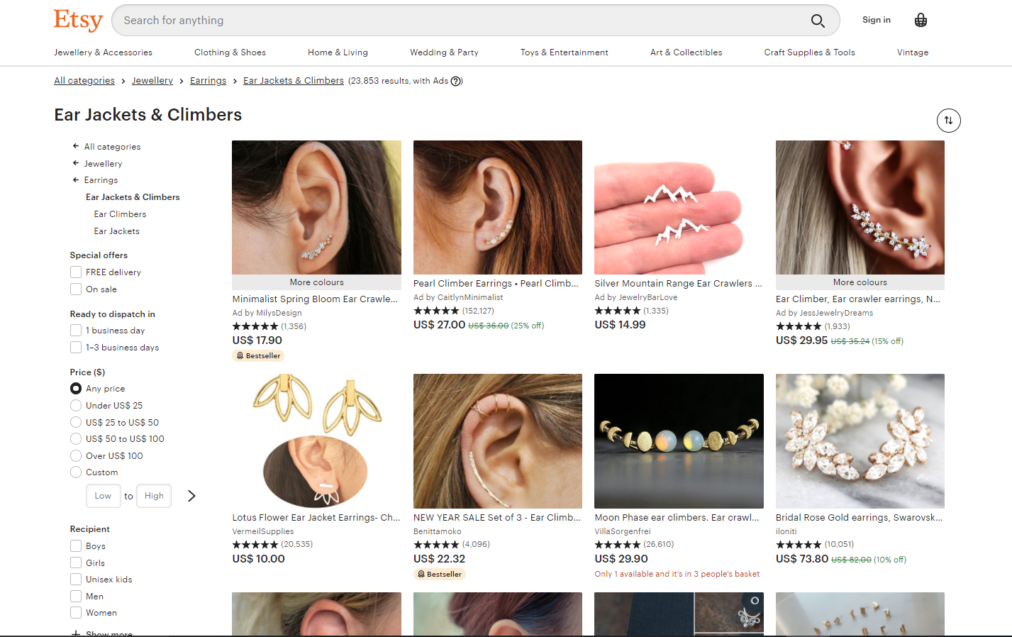
2nd sub module:Data Scrapping and Database handling
Libraries :BeautifulsoupSelenium
Our MODEL IS READYY TO MAKE THE PREDICTIONS!!
Created web scrapper and scrapped the reviews from 250 pages from Etsy.com under the Ear Jackets &Climbers and saved it into the database to test our newly created model.

Slide 8
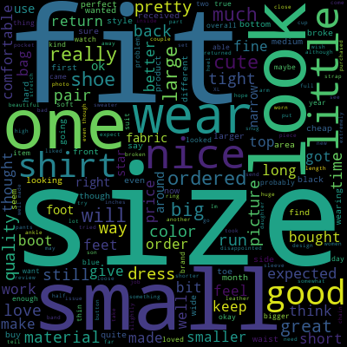
The Last step:Creating Dashboard
Dash-Dash is a productive Python framework for building web analytic applications
Our UI consists of 4 parts:
1.Word Cloud
2.Pie Chart
3.Textbox area for sentiment analysis
4.Dropdown for sentiment analysis

Slide 9
THANK YOU!!!!

